Slide 1
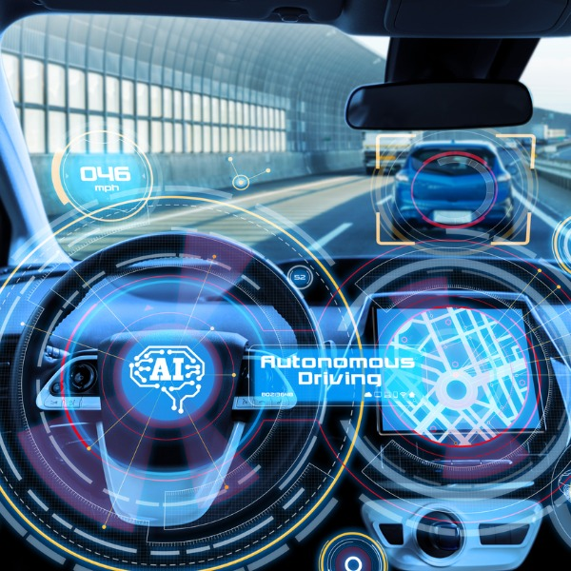

Lund University
2022 | Autonomous driving systems- generating critical Driving scenarios USING
OPTIMIZATION TO test autonomous emergency
braking systems (aebs).
BY Yamen ALBDEIWI

Slide 2
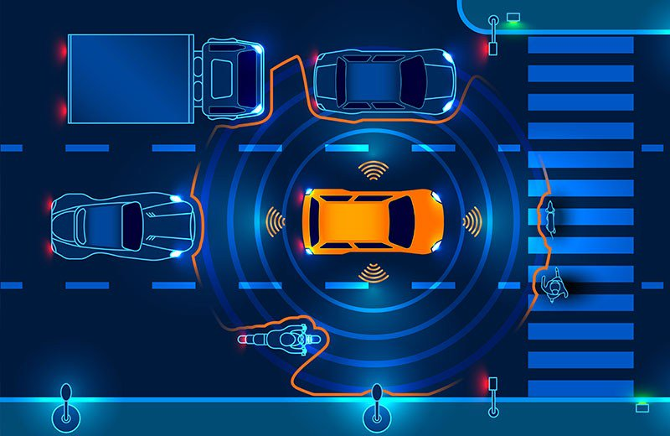
Definition of Critical Driving Scenarios (CDS)

Slide 3
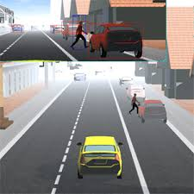
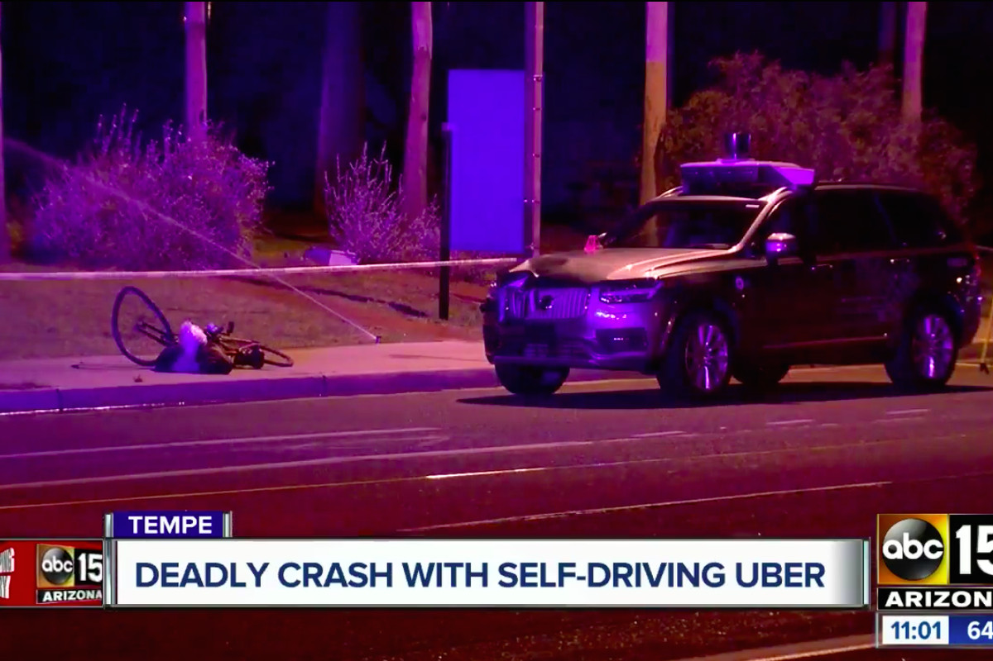
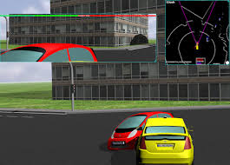
Importance of Testing CDS
ADAS has become increasingly popular.
Ensure reliability and safety of ADAS.
Discover potential defects & misbehavior in the system.
Cover rare traffic situations. (Uber’s case in USA 2018)
Avoid relaying on substantial real-world testing or
collecting real driving data at scale.
Regular road traffic is considered non-critical.
Notes:
Within the university there is also the MAX IV, International Environment Institute IIIEE, as well as several research centres and public activities. Closely linked to the university is also the Raoul Wallenberg Institute of Human Rights and Humanitarian Law.

Slide 4
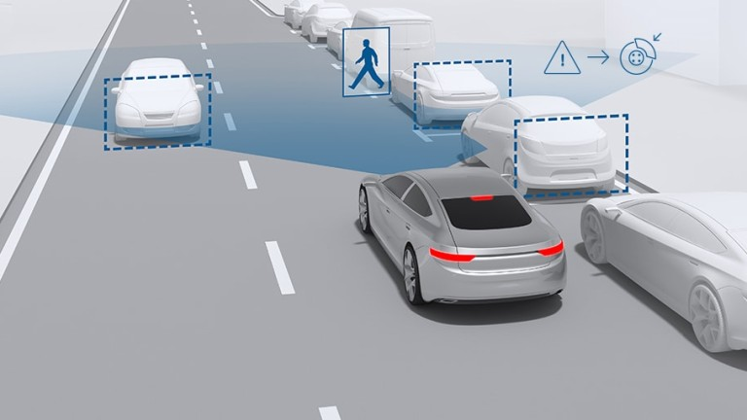
Autonomous Emergency Braking System (AEBS)
Notes:
Number of degree programs:
– 88 leading to an undergraduate degree, of which 10% taught in English.
– 187 leading to a Master’s degree, of which 79% taught in English
1 444 free-standing courses of which 8% are taught in English.
Other facts:
– 35 000 students (individuals, total per semester).
– 46 000 students (individuals, total over year).
8 400 employees, of whom 5 600 academic staff (840 professors).
Revenue: SEK 9.4 billion (1/3 education, 2/3 research).

Slide 5
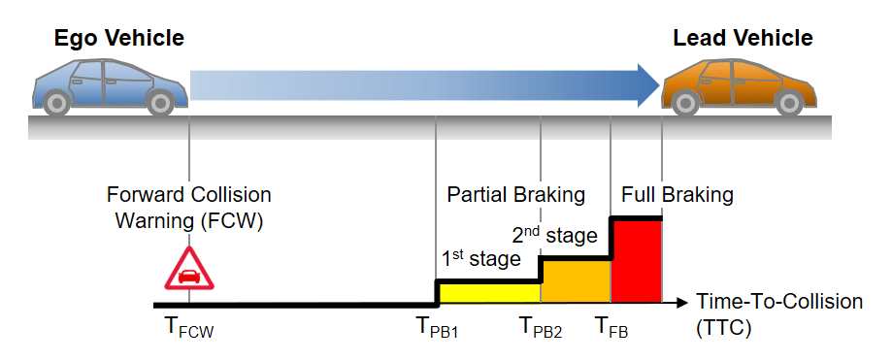

Slide 6
Methods
Simulating AEBS
Optimizing Critical Scenarios

Slide 7
Simulating AEBS:
Using MATLAB AEBS model.
Using AEBTestBench and a dataset consists of 26 important scenario categories from Euro NCAP.
Using 6 sub-models each one of them based on an algorithm written in MATLAB.
Using test requirements set.
Using Parallel Automate Testing to increase the overall automate execution speed.
Notes:
Nobel laureates: Sune Bergström (Physiology or Medicine 1982) , Arvid Carlsson (Physiology or Medicine 2000), Bertil Ohlin (Economy 1977), Bengt Samuelsson (Physiology or Medicine 1982), Manne Siegbahn (Physics 1924).
Prime minister: Swedish prime ministers Tage Erlander, Ernst Wigfors, Ingvar Carlsson.
President: Rupiah Banda, President of Zambia (2008–2001).

Slide 8
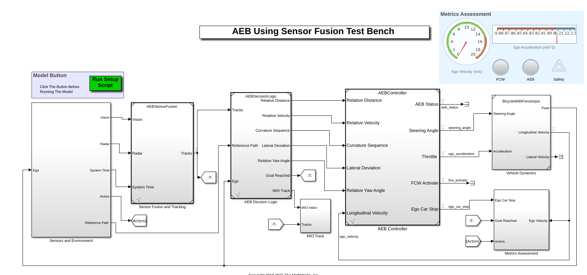
Notes:
Comprehensive university with boundary-crossing collaborations.

Slide 9
Demos:
Demo of Scenario "Pedestrian_Child" https://share.vidyard.com/watch/p3brAMW6kDhSd9x5iinYWn?
Demo of AEBS "Pedestrian_Child" https://share.vidyard.com/watch/6S6ekdJQSgwM6ddfTzJga7?

Slide 10
Optimizing Critical Scenarios:
Using modeFrontier tool.
Using multi-strategy self-adapting algorithm that combines the advantages of local and global search, in self initializing mode, which is called pilOPT.
Integrating MATLAB node with modeFrontier.
Creating a workflow of different nodes.
Define the objective as minimizing TTC while specifying upper & lower bounds for the egoVehicle’s velocity as input parameters.
Run pilOPT with 1000 evaluations.
Plot the optimized results and define a thresh hold to get extreme CDS.
Notes:
Nobel laureates: Sune Bergström (Physiology or Medicine 1982) , Arvid Carlsson (Physiology or Medicine 2000), Bertil Ohlin (Economy 1977), Bengt Samuelsson (Physiology or Medicine 1982), Manne Siegbahn (Physics 1924).
Prime minister: Swedish prime ministers Tage Erlander, Ernst Wigfors, Ingvar Carlsson.
President: Rupiah Banda, President of Zambia (2008–2001).

Slide 11
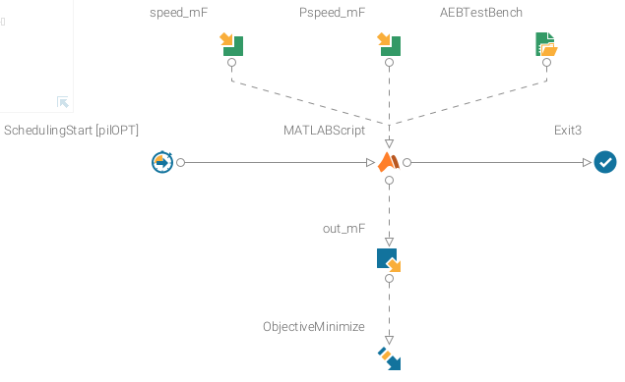
The Workflow:

Slide 12
Results
First Phase:
The entire dataset, that is, the 26 CDS imported from Euro NCAP, is passed and verified by AEBS. In each one of them, the check safety goal is achieved and the collisions are mitigated.
All test requirements are met.

Slide 13
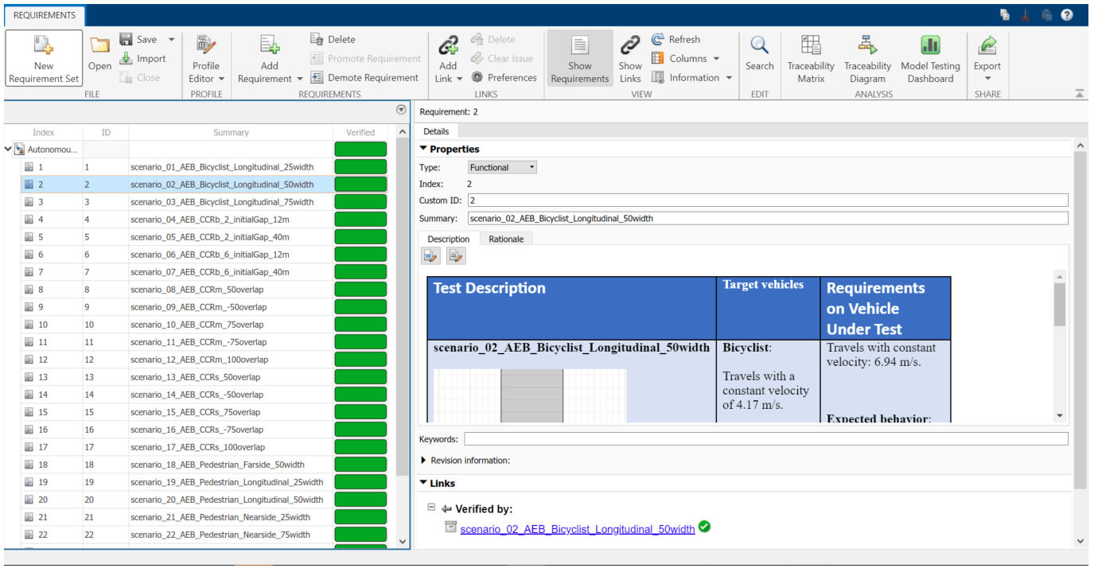

Slide 14
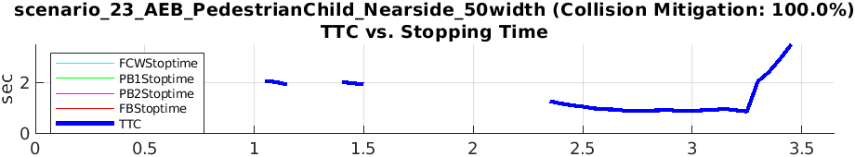

Slide 15
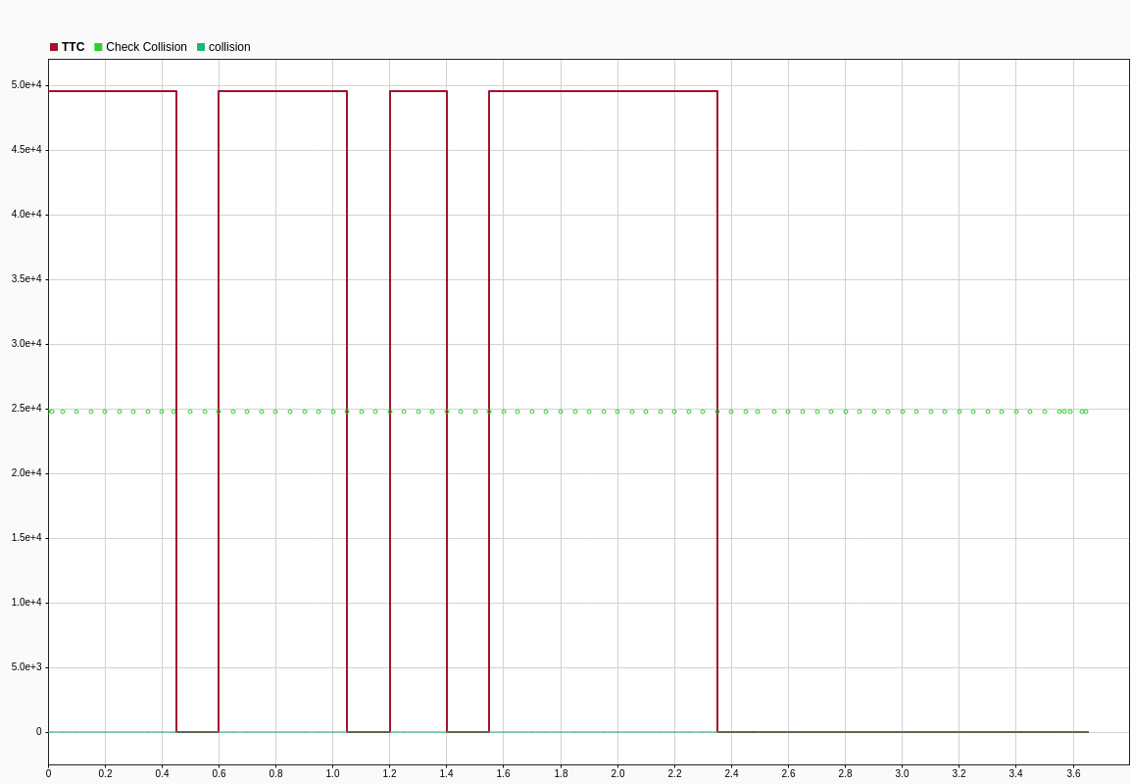

Slide 16
Results
Second Phase:
As part of the integration process, I discovered a bug in modeFrontier, which stuck during the simulation. I have logged the issue, reported it to modeFrontier’s team, and they have confirmed it.
Due to the bug, the optimization could not be carried out as planned. However, manually checking the AEBS through manual optimization, revealed a defect in which the collision could not be mitigated, and the car collided with the pedestrian/child.

Slide 17
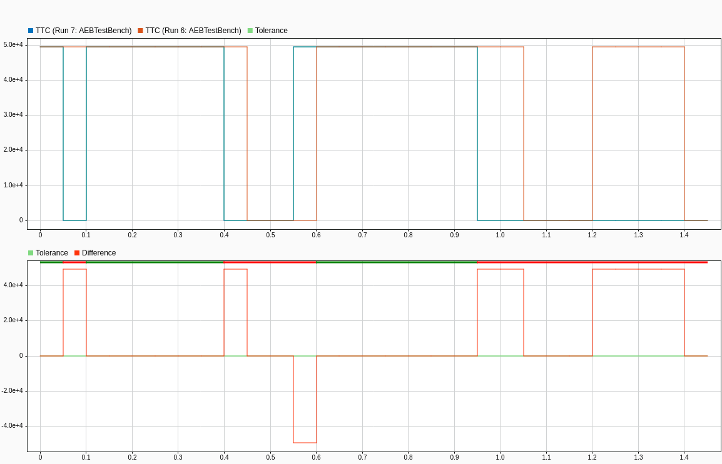

Slide 18
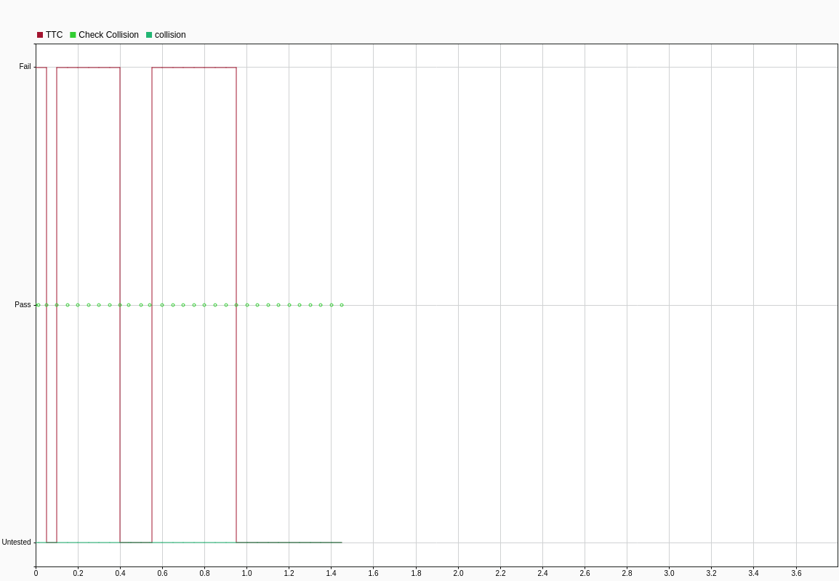

Slide 19
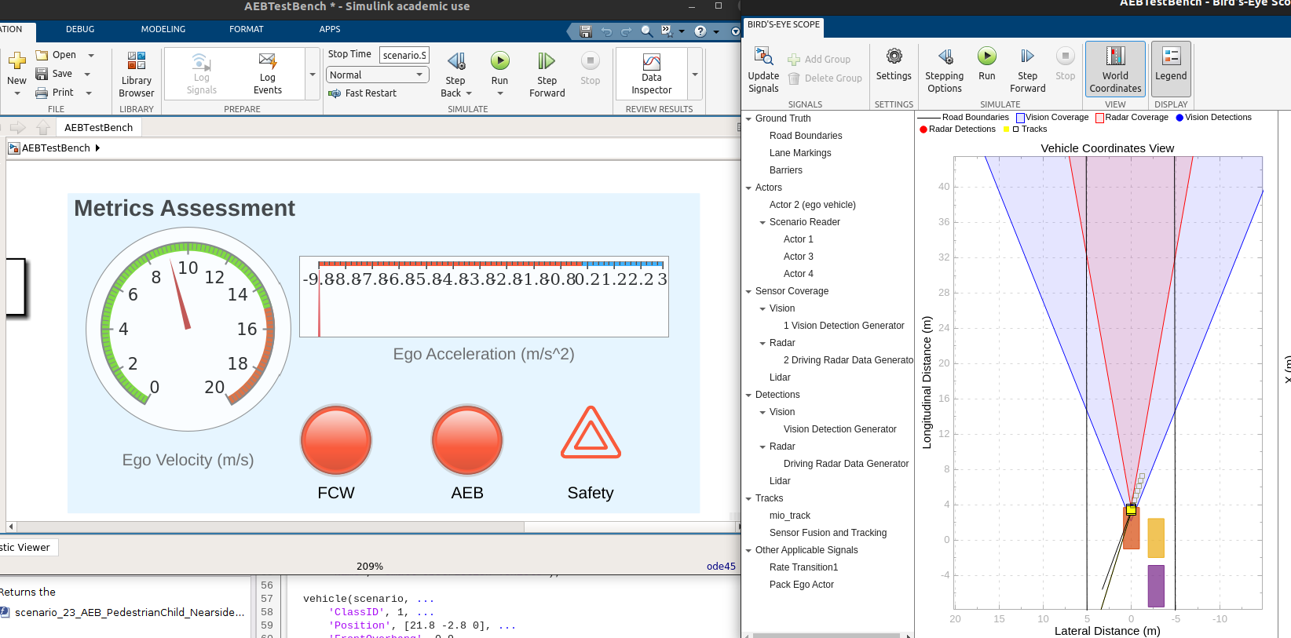

Slide 20
Conclusion
For autonomous vehicles, safety and reliability are essential attributes. In addition, due to the complexity of driving scenarios and the uncertainty of the operational environment, traditional requirements-driven testing approaches are impeded. Thus, it is necessary to identify the most critical scenarios for testing the autonomous driving systems and to uncover defects and misbehaviors. As we have seen in Uber's case, it is a life or death matter.

Slide 21

End slide. Logotype only.

